Slide 1
Earth Science Week
www.earthsci.org

Slide 2
Using Evidence in Science
Scientific Practices of the Next Generation Science Standards
Inquiry Skills in current MA learning standards
Strategy:
Using KWL with a twist making it: KLEW

Slide 3
Hurricane
Hurricane Tracker
Pull up 2012 hurricanes

Slide 4
Type | Category | Pressure(mb) | Winds (knots) | Winds (mph) | Line Color
Depression | TD | ----- | < 34 | < 39 | Green
Tropical Storm | TS | ----- | 34-63 | 39-73 | Yellow
Hurricane | 1 | > 980 | 64-82 | 74-95 | Red
Hurricane | 2 | 965-980 | 83-95 | 96-110 | Light Red
Hurricane | 3 | 945-965 | 96-112 | 111-130 | Magenta
Hurricane | 4 | 920-945 | 113-135 | 131-155 | Light Magenta
Hurricane | 5 | < 920 | >135 | >155 | White
http://weather.unisys.com/hurricane/atlantic/index.php

Slide 6
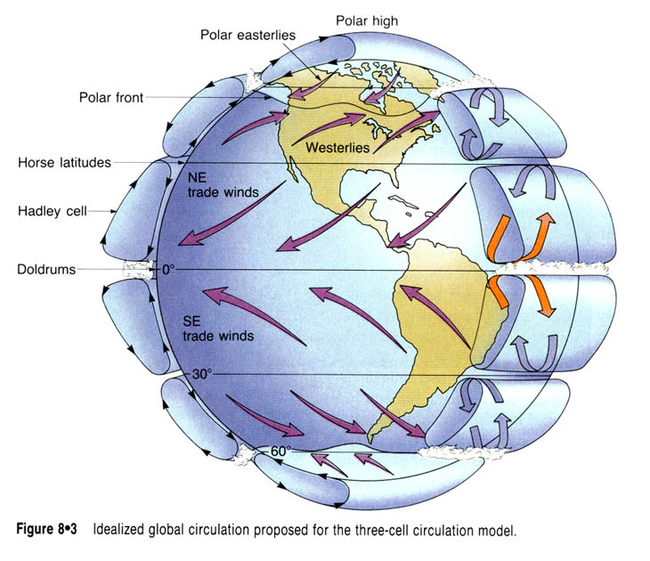

Slide 7
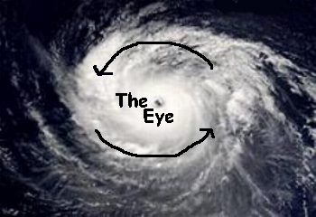

Slide 8
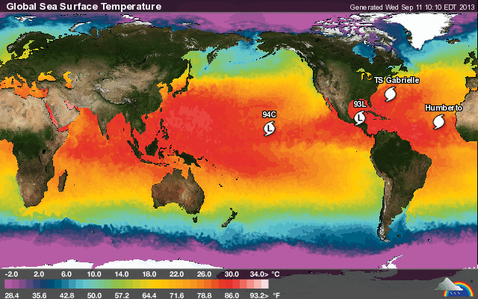
http://www.wunderground.com/hurricane/

Slide 10
Hurricanes, Typhoons, Cyclones
The West Indian name, “huracan,” from which “hurricane” is derived, is used in Atlantic storms.
Western Pacific storms are called “typhoons” from Chinese terms meaning “great winds.”
They are called “cyclones” in India, “willy-willies” in Australia, and “baquios” in the Philippines.

Slide 11
What’s in a Name?

