Slide 1
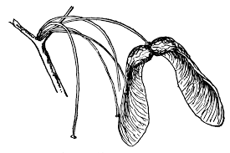
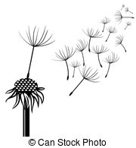
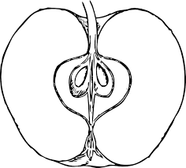
Seeds

Slide 2
Today we will
Do an Engineering Design Lesson
Integrate life science concepts with engineering
Integrate literature with “doing” engineering and science

Slide 3
What is a seed?
The Tiny Seed
Notes:
Older children: can have measured distances
https://www.youtube.com/watch?v=ls6wTeT2cKA

Slide 4
How seeds get around (seed dispersal)
Pressure Exploding from pods on a plant
Animals
Clinging on to animals,
Eaten as a fruit or nut by animals
Floating on ocean or fresh water
Wind
milkweed
Falling/gravity
maple seed
Fire

Slide 5
Being Engineers: Problem / Challenge
What is the quickest and farthest way to send a seed from one side of the room to another?

Slide 6
Doing some research: Looking more closely at seeds?
1. Form Teams and decide jobs
Team Jobs:
Manager (keep track of time, get materials for team, and make sure the team stays on task)
Presenter (read directions, share group ideas with the class)
Recorder (manages notes, design briefs, and questions with assistance from the group)
Tester (Test out the prototype and knows follows safety rules)
2. As a team, work together to describe features of this seed that you think help it get around.
3. Share with the group and compare and contrast features.
Think about this: why do you think seeds need to get from place to place?

Slide 7
Being Engineers: Problem / Challenge
What is the quickest and farthest way to send a seed from one side of the room to another?
Materials: Choose not more than 5 items from the pile. You will also need tape and scissors. One design brief page for team.
Directions: Using your observations of seeds and methods of dispersal, design a prototype seed covering that will carry your seed quickly and far.
Not more than 20 minutes to design and build it as a team.
Test it out as a group in a designated area by team. You may touch your seed device once only!
Complete your design work on the design brief page
Additional Background on Seed Dispersal

Slide 8
Evaluating our Test Results:
1. How did the prototype work? Did it go far? Fast?
2. What design features do you think helped most?
3. What features do you think could be improved? How do you think they could be improved?
4. What new ideas do you have from observing other teams?
5. If you wanted to develop a prototype that would work outside in a real habitat, what other design features would you need to consider?

Slide 9
Engineering Practices
What engineering Design Practices did you use?

Slide 10
Engineering Design Process
How did we work like an engineer? (How did I reinforce this through the lesson?)

Slide 11
Developing this for young students
How would you alter this activity for k-2?
How would you alter this activity for 3-5?
How could you integrate common core ELA? Math?

Slide 12
5E Learning Cycle?

